Slide 1
The Neighborhood Emergency Trauma Bag
HR Bohman, MD, FACS
CAPT, MC, USN (Ret)
Jefferson Healthcare Surgical Associates (Ret)

Slide 2
The Neighborhood Emergency Trauma Bag
• Why we put together the Neighborhood Emergency Trauma Bag
  designed for individuals who have little or no medical training but who may be called upon as immediate responders to provide initial trauma care and bleeding control to a victim of traumatic injury prior to the arrival of emergency medical services (EMS) or in an austere environment
Trauma is an epidemic in the US
• Intentional mass casualty incidents and natural disasters are on the rise
• 20% of trauma deaths are preventable with optimal emergency and trauma care
• Death due to bleeding can occur in minutes
• The American College of Surgeons is committed to the Zero Preventable Deaths and Stop the Bleed campaigns

Slide 3
The Neighborhood Emergency Trauma Bag
Purpose
  Initial stabilizing care of significant life-threatening injury
  Discussion of injuries for which this is beneficial
  Explanation of:
    Acute life-threatening airway and respiratory problems
    Types of shock and its treatment in a resource limited environment
  Review of contents of bag and how to use
  Documentation of treatment given

Slide 4
Platinum 10 Minutes
Proper lifesaving care within the first few minutes following injury significantly increases the survivability of those who incur these traumatic injuries (7 major injuries)
  Uncontrolled hemorrhage – severe, heavy bleeding that doesn’t stop without treatment
  Airway obstruction – something blocking the airway so that air can’t get to the lungs (usually the tongue)
  Open “sucking” chest wound – penetrating injury puts a hole in the chest that allows air to enter the chest cavity through the hole (often creating a “sucking” sound) and results in collapsed lung and inadequate oxygenation
  Tension pneumothorax – air is trapped in the chest cavity outside the lung and doesn’t allow the lung to expand with each breath which results in collapsed lung with increased pressure in chest and ultimate obstruction of blood return to heart
  Massive hemothorax – large amount of blood is trapped in the chest cavity outside the lung which doesn’t allow the lung to expand and results in collapsed lung and shock from loss of blood
  Flail chest – multiple rib fractures that don’t allow the chest to expand evenly thus making breathing difficult
  Pericardial tamponade – blood builds up in the sac that surrounds the heart and ultimately prevents the heart from pumping blood

Slide 5
Definition of Shock
“THE MANIFESTATION OF THE RUDE UNHINIGING OF THE MACHINERY OF LIFE.” Gross, 1872
A clinical condition marked by inadequate organ perfusion and tissue oxygenation

Slide 6
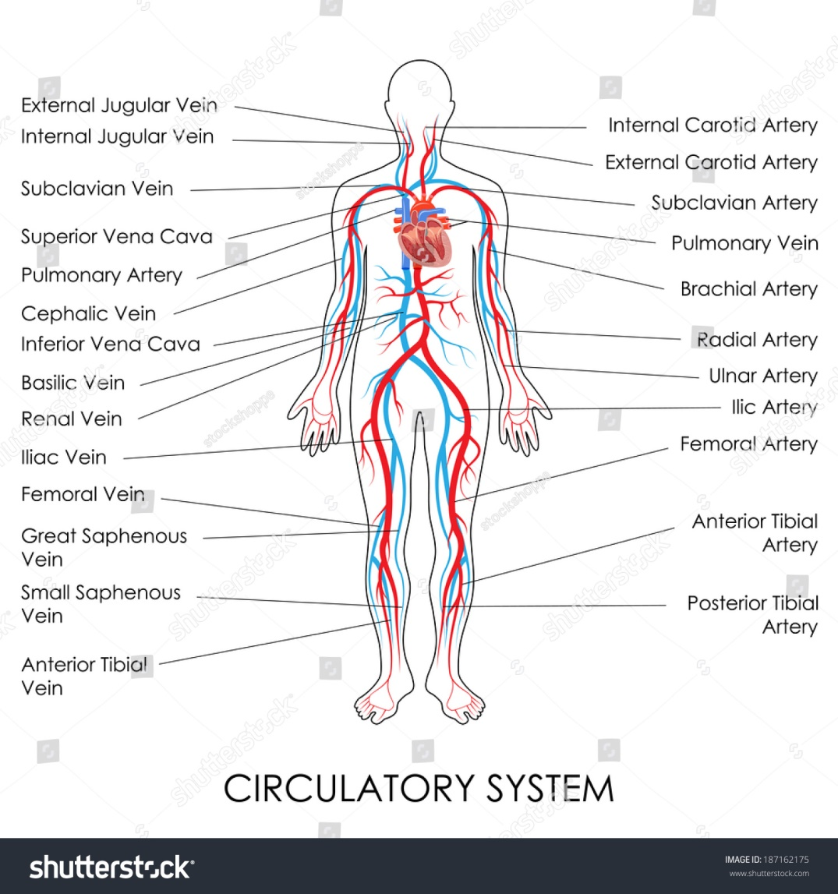
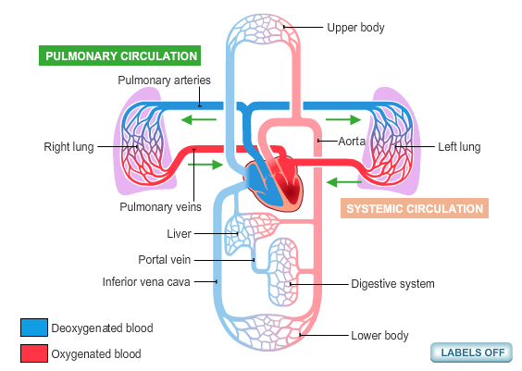
Shock – Disorder of the Circulatory System

Slide 7
Pathophysiology of Shock
In shock, there is progressive failure of the circulatory system
  There is something wrong with the pump (heart), the pipes (blood vessels), the fluid (blood volume), or it becomes obstructed (impedes blood flow)
Shock is not a single specific clinical condition.
Shock results in hypoperfusion at the cellular level with resultant cellular hypoxia. (cells run out of energy)
The body attempts to compensate by a progression of physiologic mechanisms to correct the cellular hypoxia / hypoperfusion.

Slide 8
Pathophysiology of Shock
In trauma the most common cause of shock is blood loss in which the vascular space is depleted and cannot recover fluid from the interstitial space
decreased venous return
decreased CO
compensation with increased SVR
increased tissue hypoxia

Slide 9
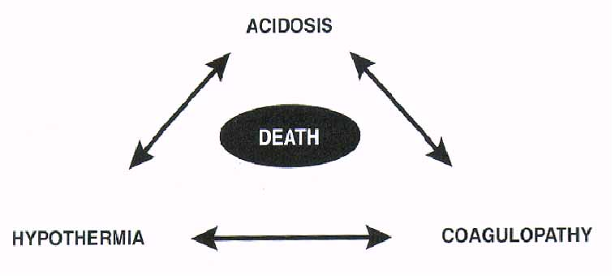
Overcoming the Triangle of Death
Rapid Surgical Intervention
& IV Resuscitation
_
_
_
_
107 degree ORs Hot Pockets
Warm IV Fluids Bair Huggers
Whole Blood
Factor VIIa
Notes:
The goal of forward surgery is life and limb salvage and must be aimed at overcoming the triangle of death. These are our limited but major capabilities for intervening against the dreaded triad.

Slide 10
Pathophysiology of Shock
Mechanisms for inadequate tissue blood flow (perfusion) include:
  Volume loss
  Pump failure
  Vasodilatation
  Obstruction
Basis for classification of types of shock

Slide 11
Classifications of Shock
Classifications based on major underlying cause of shock.
More than one type of shock may exist in a given patient.
Treatment of shock state based on treating the underlying cause or causes.

Slide 12
Classifications of Shock
Hypovolemic Shock
  Loss of fluid from the vascular space
  Makes up 75% of all cases of shock
  2 different types:
    Loss of whole blood – hemorrhage
    Loss of plasma volume – dehydration
      Burns, diarrhea, heat exhaustion, 3rd spacing, etc.

Slide 13
Classifications of Shock
Cardiogenic Shock
  Failure of the heart to adequately pump blood
  Makes up 15% of cases of shock
  2 different types:
    Coronary – blockage of blood flow to heart causing ischemia or infarction of heart muscle.
    Non-coronary – failure of heart to pump not related to blood flow to heart muscle
      Arrhythmias, ruptured valve, cardiomyopathy, etc.

Slide 14
Classifications of Shock
Distributive Shock
  Caused by an inappropriate redistribution of blood flow to the tissues
  Makes up 8% of cases of shock
  3 different types:
    Neurogenic – loss of peripheral vasomotor tone with pooling
    Septic – inflammatory mediated microvascular injury with capillary permeability and mismatched blood flow
    Anaphylactic – histamine induced vasodilatation and vascular permeability

Slide 15
Classifications of Shock
Obstructive Shock
  Impedes flow of blood through vascular system
  Makes up only 2% of shock cases
  2 different types:
    Occlusive –
      Pulmonary Embolus – blood clot blocks pulmonary artery
      Air Embolus – air blocks right ventricle
    Compressive –
      Tension Pneumothorax – compresses great veins and blood return to heart
      Cardiac Tamponade – compresses cardiac chambers and prevents filling of ventricles

Slide 16
Clinical Features of Shock
Hypovolemic Shock
  Most common type of shock in trauma
  Due to hemorrhage until proven otherwise
  Clinical manifestations related to amount of circulating blood volume lost
  Normal blood volume is 7% of body weight in Kg
  Average blood volume in 70 Kg man is 5 liters

Slide 17
Clinical Features of Shock
Classes of Hypovolemic Shock
  Class I – loss of up to 15% blood volume
    Up to 750 cc blood loss
    No clinical signs or symptoms
    Equivalent to donating 1-1½ units of blood
    Heart rate, blood pressure and capillary refill normal
    Replace with crystalloid or oral fluids

Slide 18
Clinical Features of Shock
Classes of Hypovolemic Shock
  Class II – loss of 15%-30% blood volume
    750 – 1500 cc blood loss
    Mild tachycardia
    Decreased pulse pressure
    Systolic pressure unchanged
    Mild tachypnea
    Decreased urinary output (20-30 cc/h)
    Anxious, hostile, or frightened
    Replace with crystalloid, possible blood

Slide 19
Clinical Features of Shock
Classes of Hypovolemic Shock
  Class III – loss of 30% - 40% blood volume
    1500 – 2000 cc blood loss
    Marked tachycardia
    Marked tachypnea
    Decreased BP
    Oliguria
    Confusion, apathy
    Replace with crystalloid and blood

Slide 20
Clinical Features of Shock
Classes of Hypovolemic Shock
  Class IV – loss of > 40% blood volume
    > 2000 cc blood loss
    Life-threatening exsanguination
    Significant tachycardia
    Marked tachypnea
    Significant depression BP
    Narrow pulse pressure or unobtainable diastolic
    Cold and pale skin
    Lethargic to comatose
    Urine output negligible
    Require rapid infusion blood and crystalloid

Slide 21
Clinical Features of Shock
  Manifestations:Tachycardia, hypotension, tachypnea and cutaneous vasoconstriction
  “…any injuries patient who is cool and
  tachycardic is in shock until proven otherwise.”
  ATLS 6th ed Decreased urine output
  Narrowed pulse pressure
  Decreased mental status

Slide 22
Clinical Features of Shock
Cardiogenic Shock
  Failure of the pump
  Irregular heart beat
    Tachycardia, PSVT, A. Fib, PVC’s, V. Tach, V. Fib
  Tachypnea, Shortness of Breath
  Skin cool and clammy
  Peripheral and central cyanosis
  Decreased urine output
  Engorged neck veins

Slide 23
Clinical Features of Shock
Distributive Shock
  Loss of autoregulation of blood distribution
  Neurogenic
    Hypotension and bradycardia
    Neurologic changes – paralysis, sensory deficits
    Normal capillary refill
  Septic
    Tachycardia, late hypotension
    Skin pink, warm and dry
    Fever or hypothermia
  Anaphylactic
    Tachycardia and hypotension
    Wheezing, stridor, hives
    Vomiting, abdominal cramps, diarrhea

Slide 24
Clinical Features of Shock
Obstructive Shock
( Impedes blood flow)
  Occlusive
    Pulmonary Embolus
      Sudden severe hypoxia
      Underlying risk factors
    Air Embolus
      Murmur – “washing machine in heat”
      Air entry site
        Penetrating chest trauma with open pneumothorax
        Open central lines
  Compressive
    Tension pneumothorax
      Absent breath sounds
      Hyper-resonance
      Deviated trachea
      Distended neck veins
    Cardiac tamponade
      Hypotension
      Muffled heart tones
      Distended neck veins

Slide 25
Shock Summary
Time is of the essence
All trauma patients are in hypovolemic shock till proven otherwise
  Common things occur commonly, but…
  If you never think of a diagnosis – you will never make it

Slide 26
Management Plan
Stop life-threatening external hemorrhage !
Assure a secure airway if unconscious
  Head tilt - Chin lift
  Jaw-thrust with neck stabilization if suspected neck injury
  Nasopharyngeal or oral airway
Treat breathing issues
  Vent a tension pneumothorax
  Cover a sucking chest wound
  Support ventilation if needed (Ambu bag, oxygen)

Slide 27
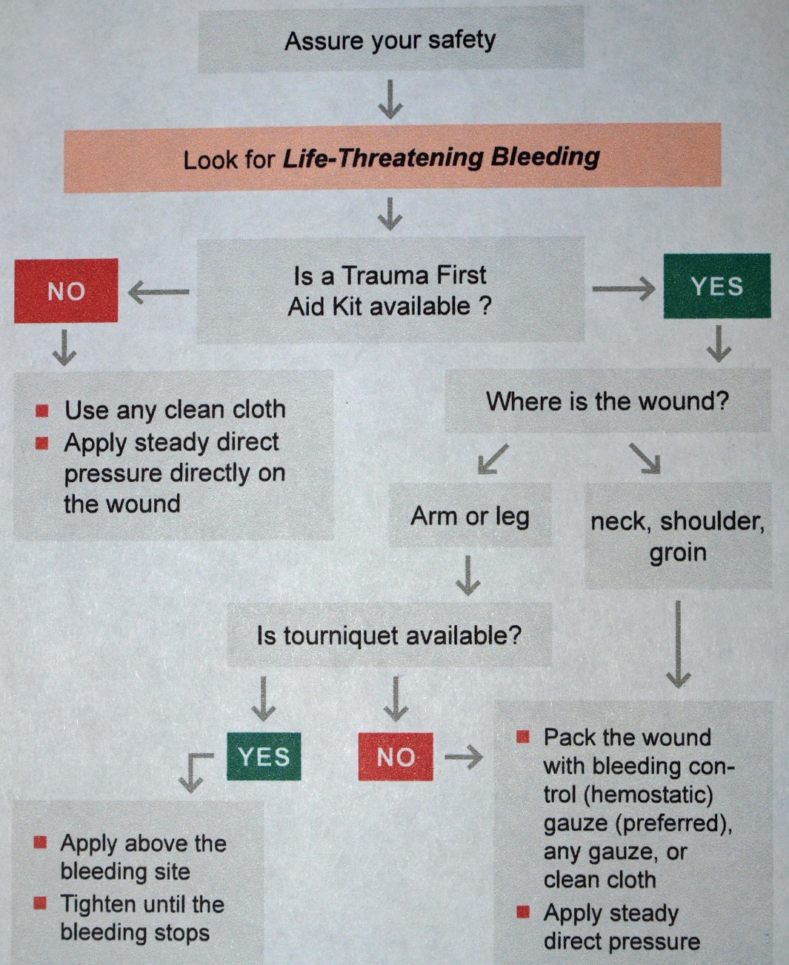
Management Plan – External Bleeding

Slide 28
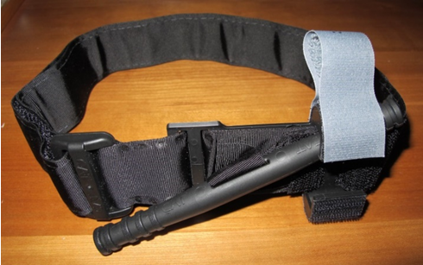
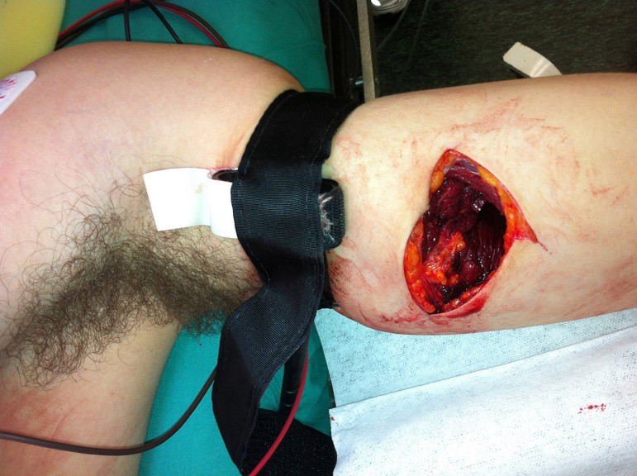
Management Plan – External Hemorrhage
Place a tourniquet

Slide 29
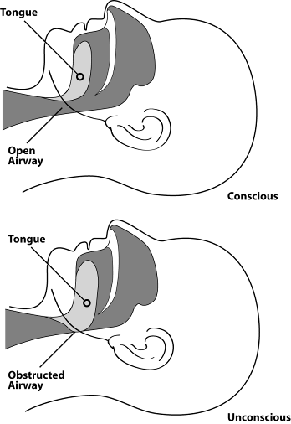
Management Plan – Airway Obstruction
Assure a secure airway if unconscious
  Head tilt - Chin lift
  Jaw-thrust with neck stabilization if suspected neck injury
  Nasopharyngeal or oral airway

Slide 30
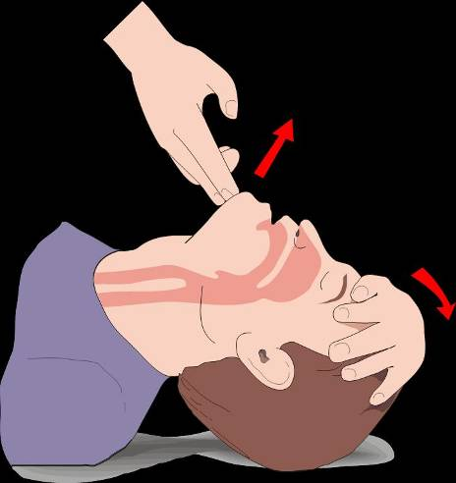
Management Plan – Airway Obstruction

Slide 31
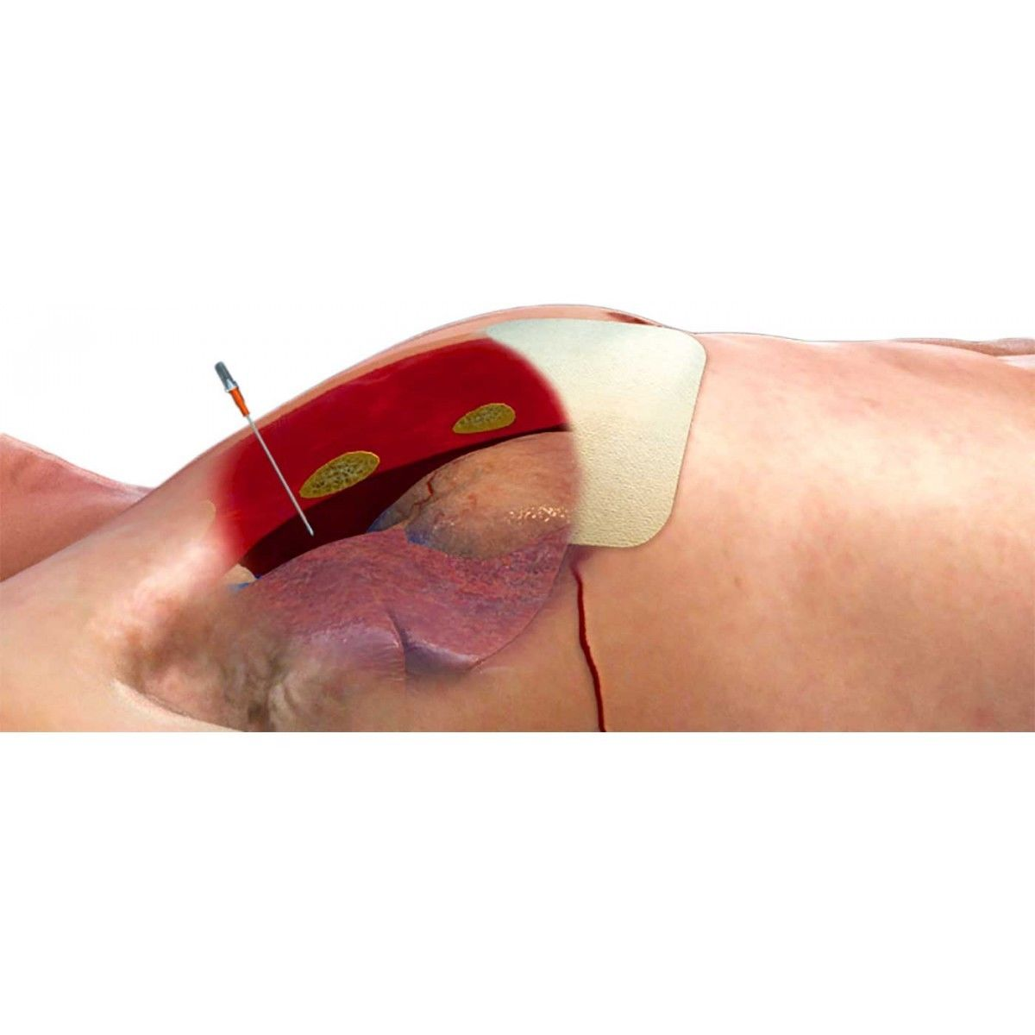
Management Plan – Breathing Issues
Treat breathing issues
  Vent a tension pneumothorax
  Cover a sucking chest wound
  Support ventilation if needed (Ambu bag, oxygen)

Slide 32
Management Plan – After ABC’s
Secure vascular access
Hypotensive resuscitation if bleeding not controlled
Splint fractures
Treat and cover open wounds
Prevent Hypothermia
Monitor and re-triage
Document the care given
Transport to definitive care ASAP

Slide 33
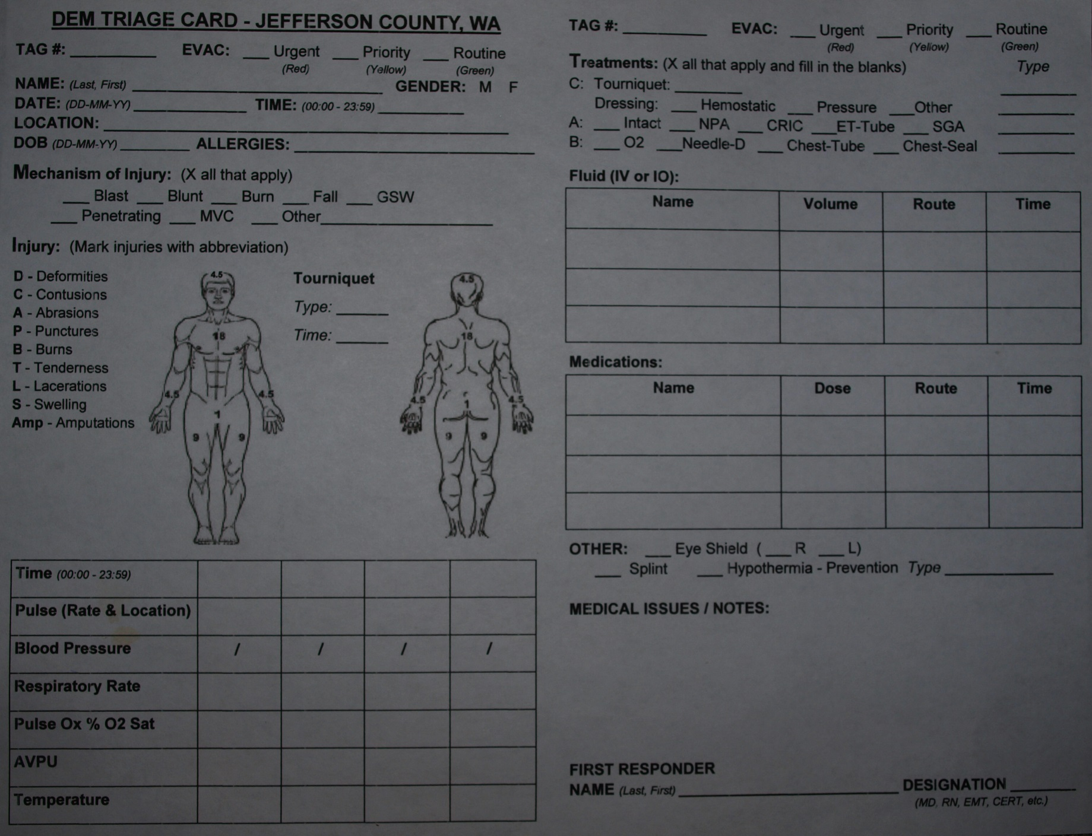
Management Plan – Documentation Care

Slide 34
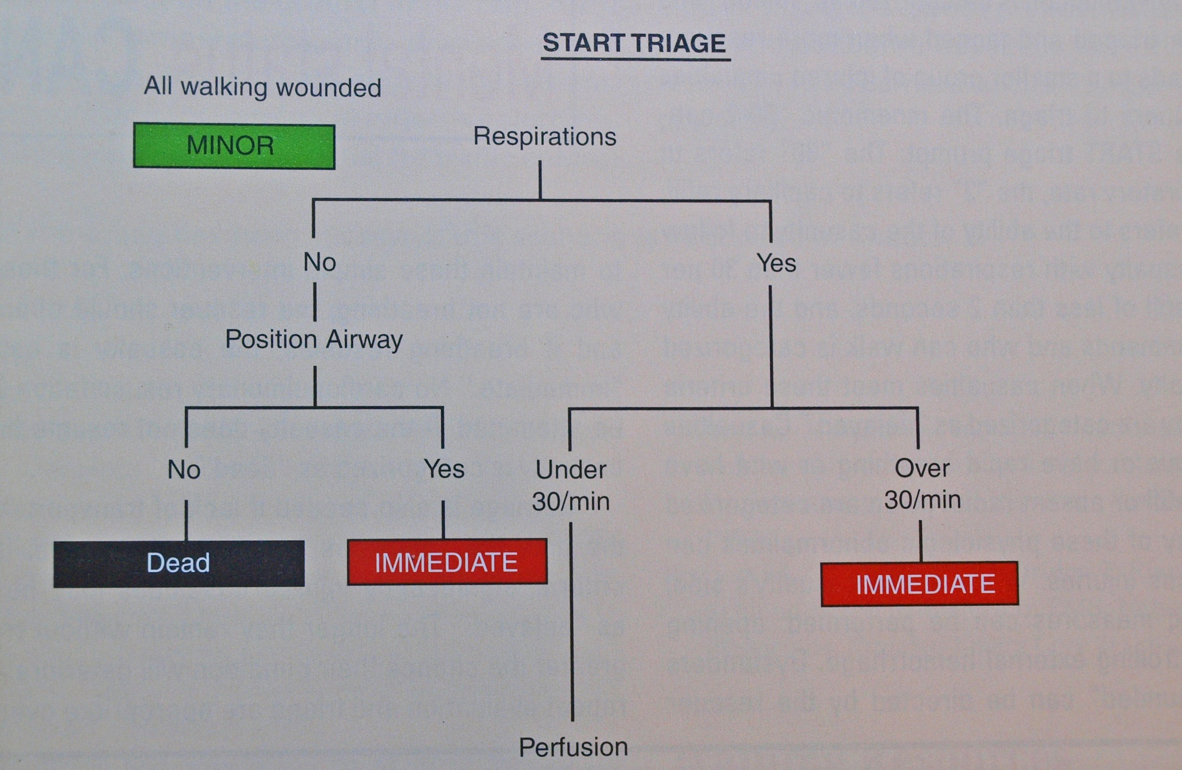
Triage

Slide 35
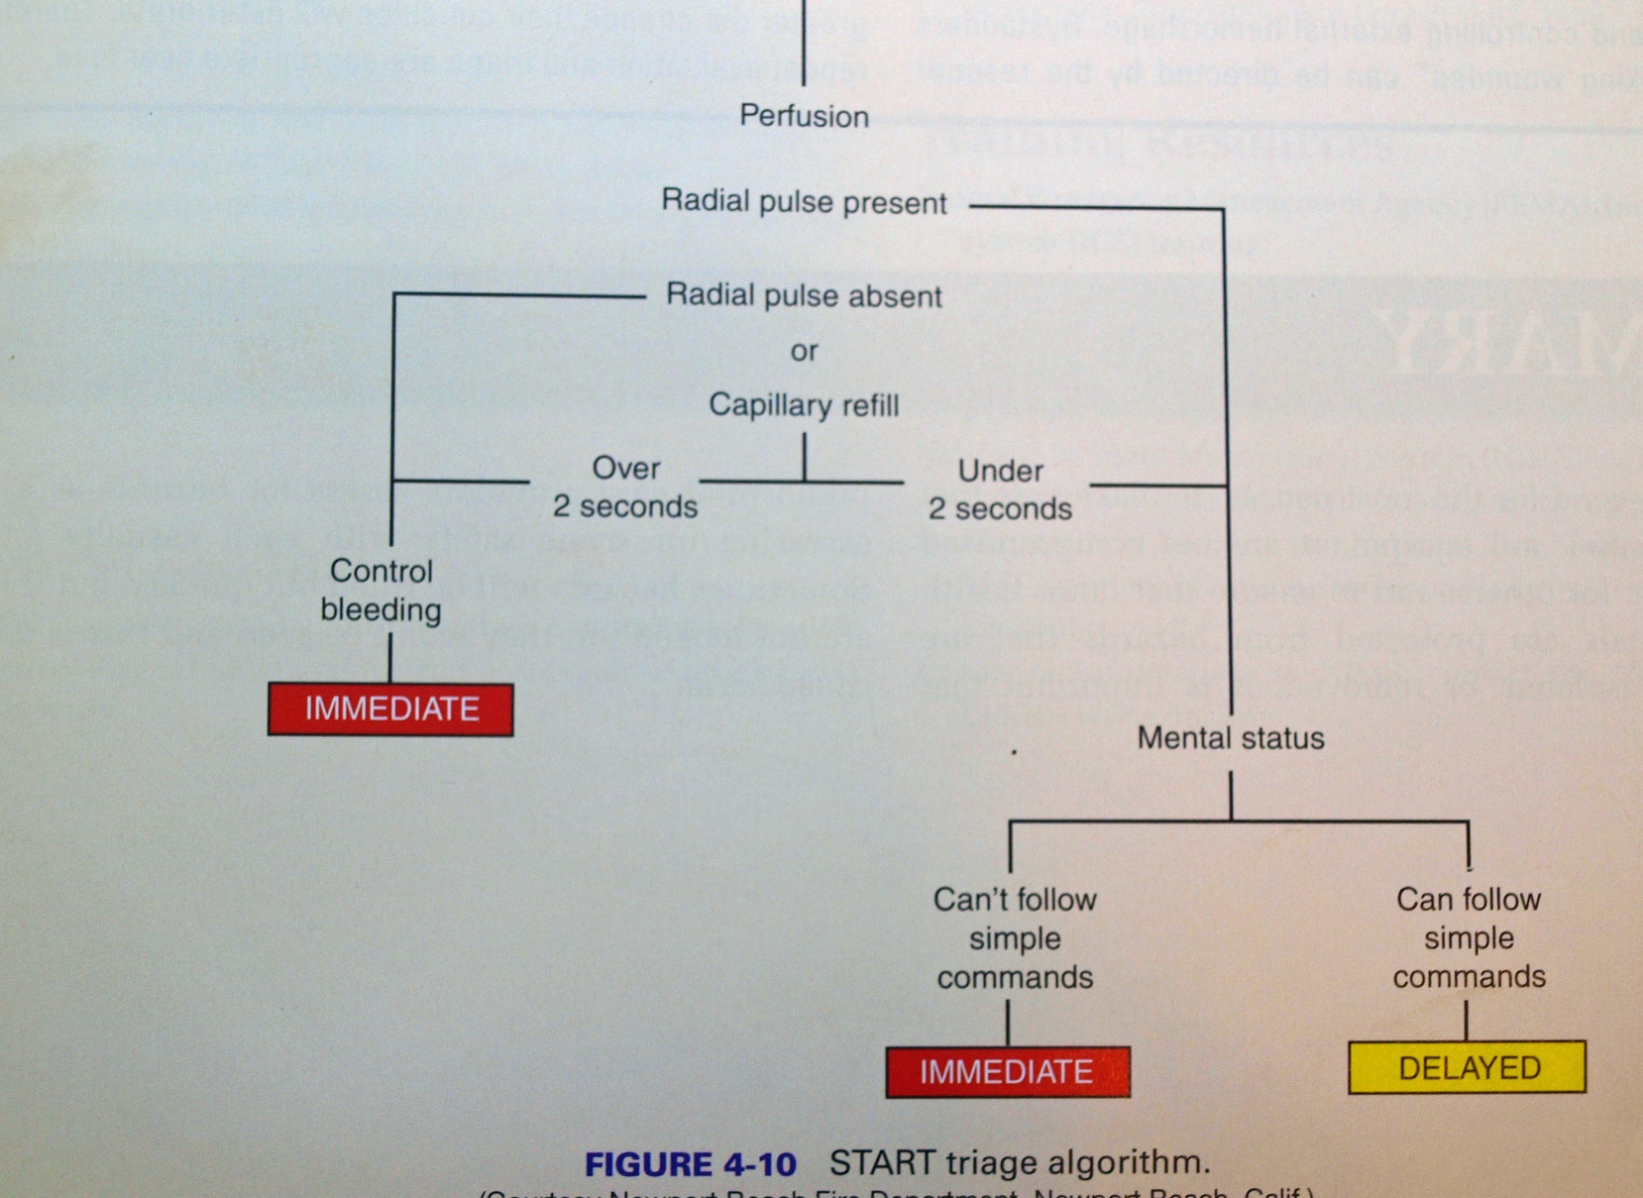
Triage

Slide 36
The Neighborhood Emergency Trauma Bag
Contents
2 Space Blankets
1 CAT Tourniquet
1 Collapsible Litter
2 Chux Pads 23”X36” for litter
3 Abdominal Bandages 8”X10”
1 Elastic Bandage 4”X5yds
1 Elastic Bandage 6”X5yds
2 4X4 Sterile Gauze Sponges (10/box)
1 4X4 Non-Sterile 8-ply Gauze Sponges (200/bag)
1 Stop the Bleed Kit – Advanced or items below:
  1 Permanent Marker
2 Pair of gloves – latex free, large
1 CAT Tourniquet
1 Emergency Bandage
1 Pair of Trauma Shears 7.5”
2 Rolls of Primed, Compressed Gauze Dressing
1 Pack of HALO Vents (2/pk)
1 QuickClot Combat Gauze 3”X4yds
1 Body Bag (hypothermia prevention)
4 Hand & Body Warmers – 18hrs
1 3” Silk Tape Rolls
1 Hand Sanitizer – 3 oz.
1 Chest Decompression Needle – 10 gauge, 3.25” long
1 Blue Nitrile Exam Gloves – size large 100/box
1 Penlight – LED Medical
1 Alcohol Pads – 200/box
1 Fingertip Pulse Oximeter Blood O2 Sat. Monitor
1 Stethescope & Blood Pressure Cuff – Manual Adult
1 SAM Splint XL 5.5”X36” Rolled
1 Safety Goggles
1 Betadine Solution 4 oz. bottle
If your neighborhood has medically trained personnel, please consider adding:
1 Emergency Cricothyrotomy Kit 3
1 Nasopharyngeal 9pc (20F-36F) Airway Kit
1 Russell Pneumo Fix Chest Decompression Device w/needle
1 Ambu Bag w/ mask

